Slide 1
My Work Experience
2017

Slide 2
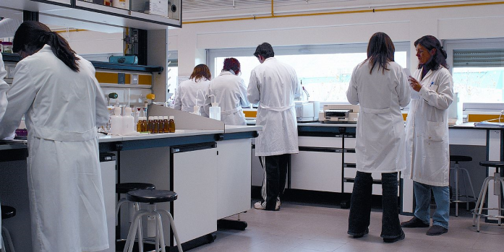
WIT Science Department
For week one, I was in the WIT Science Department.
At the beginning of the week, I was given a timetable putting me into random science classes that were going on during that week.

Slide 3
Day One
The first lab I went to was called inorganic chemistry and it started at 9.15am and lasted 2.5 hours. I got to watch the experiment taking place and I was given an easier version of the experiment to do myself.
Later that day I went to a lab called pharmaceutical science. This lab was with 3rd years, so I just watched. This lab was finished at 5.15pm.

Slide 4

Day Two
On the second day, I had three labs. The first lab was pharmaceutical biotechnology. I found this really interesting. This was a 3rd year class. It involved swapping different parts of DNA between two cells until they glowed in the dark.
Later I had introductory chemistry where I did an experiment that I had done last year.
Then I had Good Lab Practice where I learned the rules of the lab. I finished at 5.15pm again.

Slide 5

Day Three
On Thursday I had two labs. First was food formulation where I learned what different types of food was made up of. I found this really interesting and I also got to test different foods.
Then I had physics. In this class, I did experiments based on light and pressure. I thought it was hard. This class also involved maths.
I was finished at 3.15.

Slide 6

Day Four
This was my last day. My first class was called food analysis which involved testing food, similar to the food formulation class I had on Wednesday.
My very last class was micro-biology where I watched the students grow bacteria from agar plates. I got to use the microscope to look at the bacteria.
I was finished at 1.15pm on Friday.

Slide 7
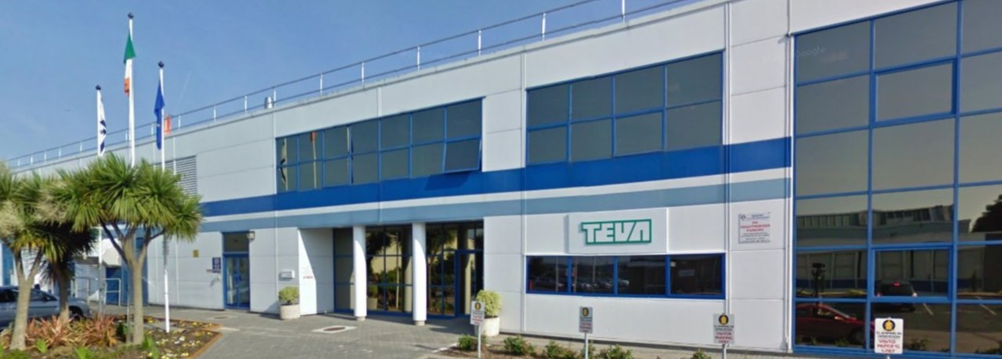
TEVA Pharmaceuticals
For week two, I was in Teva, which is a factory that makes inhalers.
I was in the science and human resources department.

Slide 8
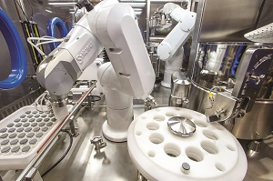
TEVA Pharmaceuticals
On the first day, I had to be trained on the rules before I was allowed to get any tours of the labs.
On the second day, I was with the engineers. They were the ones who designed the structure of the inhalers. They showed me how to make 3D objects on the computer.
On the third day, they showed me the robots that actually make the inhalers.

Slide 9
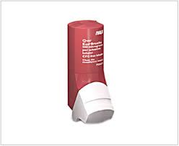
TEVA Pharmaceuticals
On the fourth day, I was given a tour of the lab where the powder that goes inside the inhalers is made. I also had to do a sample interview for the market research of selling the inhalers.
On the last day, I had to file away forms. This was for the whole day.

Slide 10

WIT
Good Points:
Different every day
Interesting
Something new
Practical work
Bad Points:
Classes were long

Slide 11

Teva
Good Points:
Tours were interesting
Learned new information
Bad Points
Repetitive
Mostly observing
Lots of paperwork

Slide 12
Going Forward
I really enjoyed the WIT placement. I found it really interesting and it was different every day. I might consider a job like this in the future.
I found the placement in Teva boring. I enjoyed the tours, but it was very repetitive. It was okay for the week but I don’t think that I would like a job in this area.

